Slide 1
American Healthcare: Issues, Reform, Response
Patricia A. Gabow, M.D.
City Club
November 2010

Slide 2
American Healthcare
Issues in American healthcare
Goals of reform
New healthcare models

Slide 3
American Healthcare
American Healthcare has serious problems
  Coverage/Access
  Cost
  Quality/Safety
  Disparity/Variability
  Workforce

Slide 4
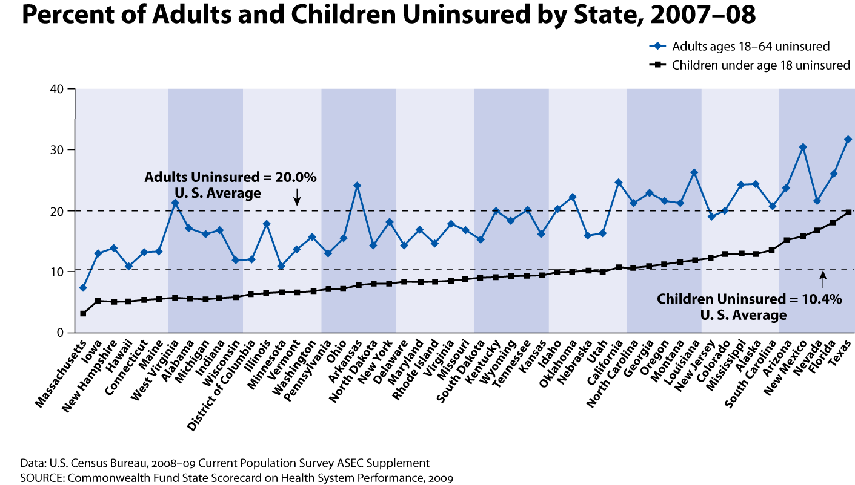
American Healthcare

Slide 5
American Healthcare
        Coverage = Access

Slide 7
American Healthcare
Source: Organization for Economic Cooperation and Development (OECD) McKinsey 2008

Slide 8
American Healthcare

Slide 9
Exhibit ES-6. Total National Health Expenditure (NHE) Growth by
Provider Sector, Current Projections and with Policy Changes, 2009–2020
Total NHE
All other
Physician & other professional
Hospital
Projected Growth, Current Policy
Expenditure (trillions)
Data: Estimates by The Lewin Group for The Commonwealth Fund.
Source: The Path to a High Performance U.S. Health System: A 2020 Vision and the Policies to Pave the Way, February 2009.

Slide 10
Why Reform
Scores: Dimensions of a High Performance Health System
10
Source: Commonwealth Fund National Scorecard on U.S. Health System Performance, 2008

Slide 11
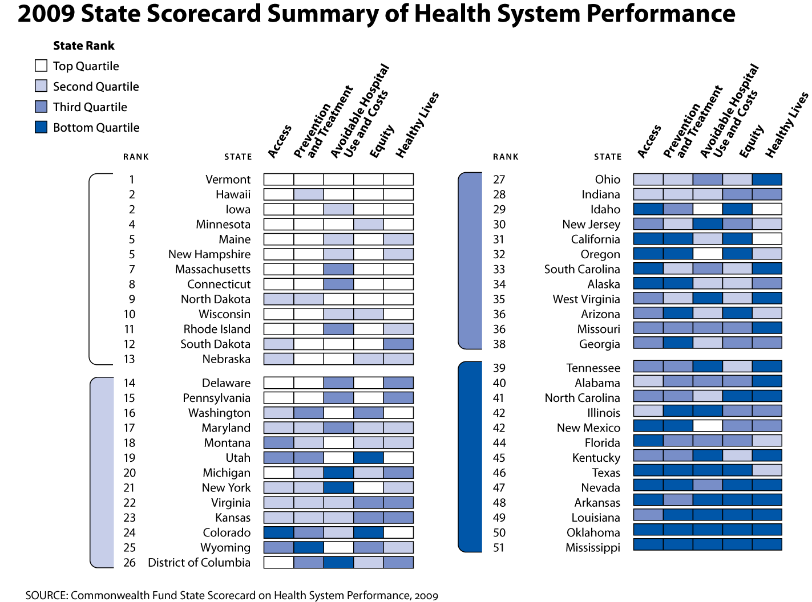

Slide 12
Preventive Care Visits for Children, by Top and Bottom States, Race/Ethnicity, Family Income, and Insurance, 2003
Percent of children (ages <18) who received BOTH a medical and dental preventive care visit in past year
FPL = federal poverty level.
Source: Commonwealth Fund National Scorecard on U.S. Health System Performance, 2006. Data: 2003 National Survey of Children’s Health (HRSA 2005; retrieved from Data Resource Center for Child and Adolescent Health database at http://www.nschdata.org).

Slide 13
American Healthcare
American health care issues
  Coverage/Access – 50 million Americans are uninsured
  Cost – 2.5 trillion dollars (x 2 other)
  Quality – overall “C” grade
  Disparity in geography, income, race

Slide 14
American Healthcare
Goals of Reform
  Achieving near universal coverage
  Improving access to care (primary care)
  Improving quality
  Creating meaningful transparency
  Expanding health care work force
  Bending the cost curve

Slide 15
American Healthcare
Achieving near universal coverage
Insurance reforms
  Dependent coverage to age 26
  Elimination of exclusions and lifetime max
Small business subsidies
Expansion of Medicaid (poorest) (2014)
Subsidized premiums (near poor) (2014)
Individual mandate

Slide 16
American Healthcare
Improving Access to Care—Primary Care
  Payment increases for Primary Care
  Community health centers expansion (ARRA)
  Workforce expansion
  Medical Homes
  Medicare Health Assessment
  No co-pay for prevention

Slide 17
American Healthcare
Improving Quality
  Medical Homes
  ACO’s
  Meaningful transparency
  HIT (ARRA)
  Funding NQF
  Not paying for bad outcomes (costs)
  Focus on Dual Eligible (cost)
  Center for Comparative Effectiveness (cost)

Slide 18
American Healthcare
Bending the cost curve
  Rate reduction—Medicare Advantage
  Moving from straight fee for service (ACO)
  Not paying for undesirable outcomes (quality)
  Focus on Duals (quality)
  Independent Review Commission
  MACPAC
  Fraud and abuse

Slide 19
American Healthcare
To achieve goals of health reform:
  New models of American health must occur
  These models will come from transformation at individual system levels
  Creation of these models will require broad vision, new approaches and willingness of all components to embrace a new reality

Slide 20
American Healthcare
Characteristics of new models
  Integrated systems of care
  Global payments-end of fee for service
  True meaningful use of HIT
  Removal of waste from the system
  Transformation from revenue system to a health care system

Slide 21
American Healthcare
“Denver Health possesses many of the essential components of a high performing health system…. Its best practices and the lessons learned from the significant barriers it has overcome, can form a “learning laboratory”—a potential model—from which other states and the nation may benefit.”
  Source: Denver Health: A High Performance Public Health Care System – Commonwealth Fund, 2007

Slide 22
American Healthcare
Why is Denver Health a model
Integrated system
Employed high quality physicians
Independent governmental entity
Sophisticated use of information technology
Cost effective
Outstanding quality
Committed to innovation

Slide 23
American Healthcare
Integrated system of care provides coordinated care across a patient’s life and across the continuum of disease.
Integrated systems get patient to the right place, at the right time, with the right provider, at the right cost, with the right outcome.

Slide 24
HIT
Employed Physicians
Denver Health Medical Center
Rky Mtn Regional Trauma Ctr
Rocky Mtn Center for Medical Response to Terrorism
911
Public Health
Regional Poison Center & Nurseline
Family Health Centers
School-based Health Centers
Denver Health Medical Plan
Correctional Care
Denver Cares

Slide 25
Denver Health Patients
Denver Health cares for over 163,000 individual patients – more than one third of Denver County’s population
37% of Denver’s babies are born at Denver Health
40% of Denver children use Denver Health
70% of patients are ethnic minorities
75% of patients are below 185% FPL
46% of patients are uninsured
25

Slide 26
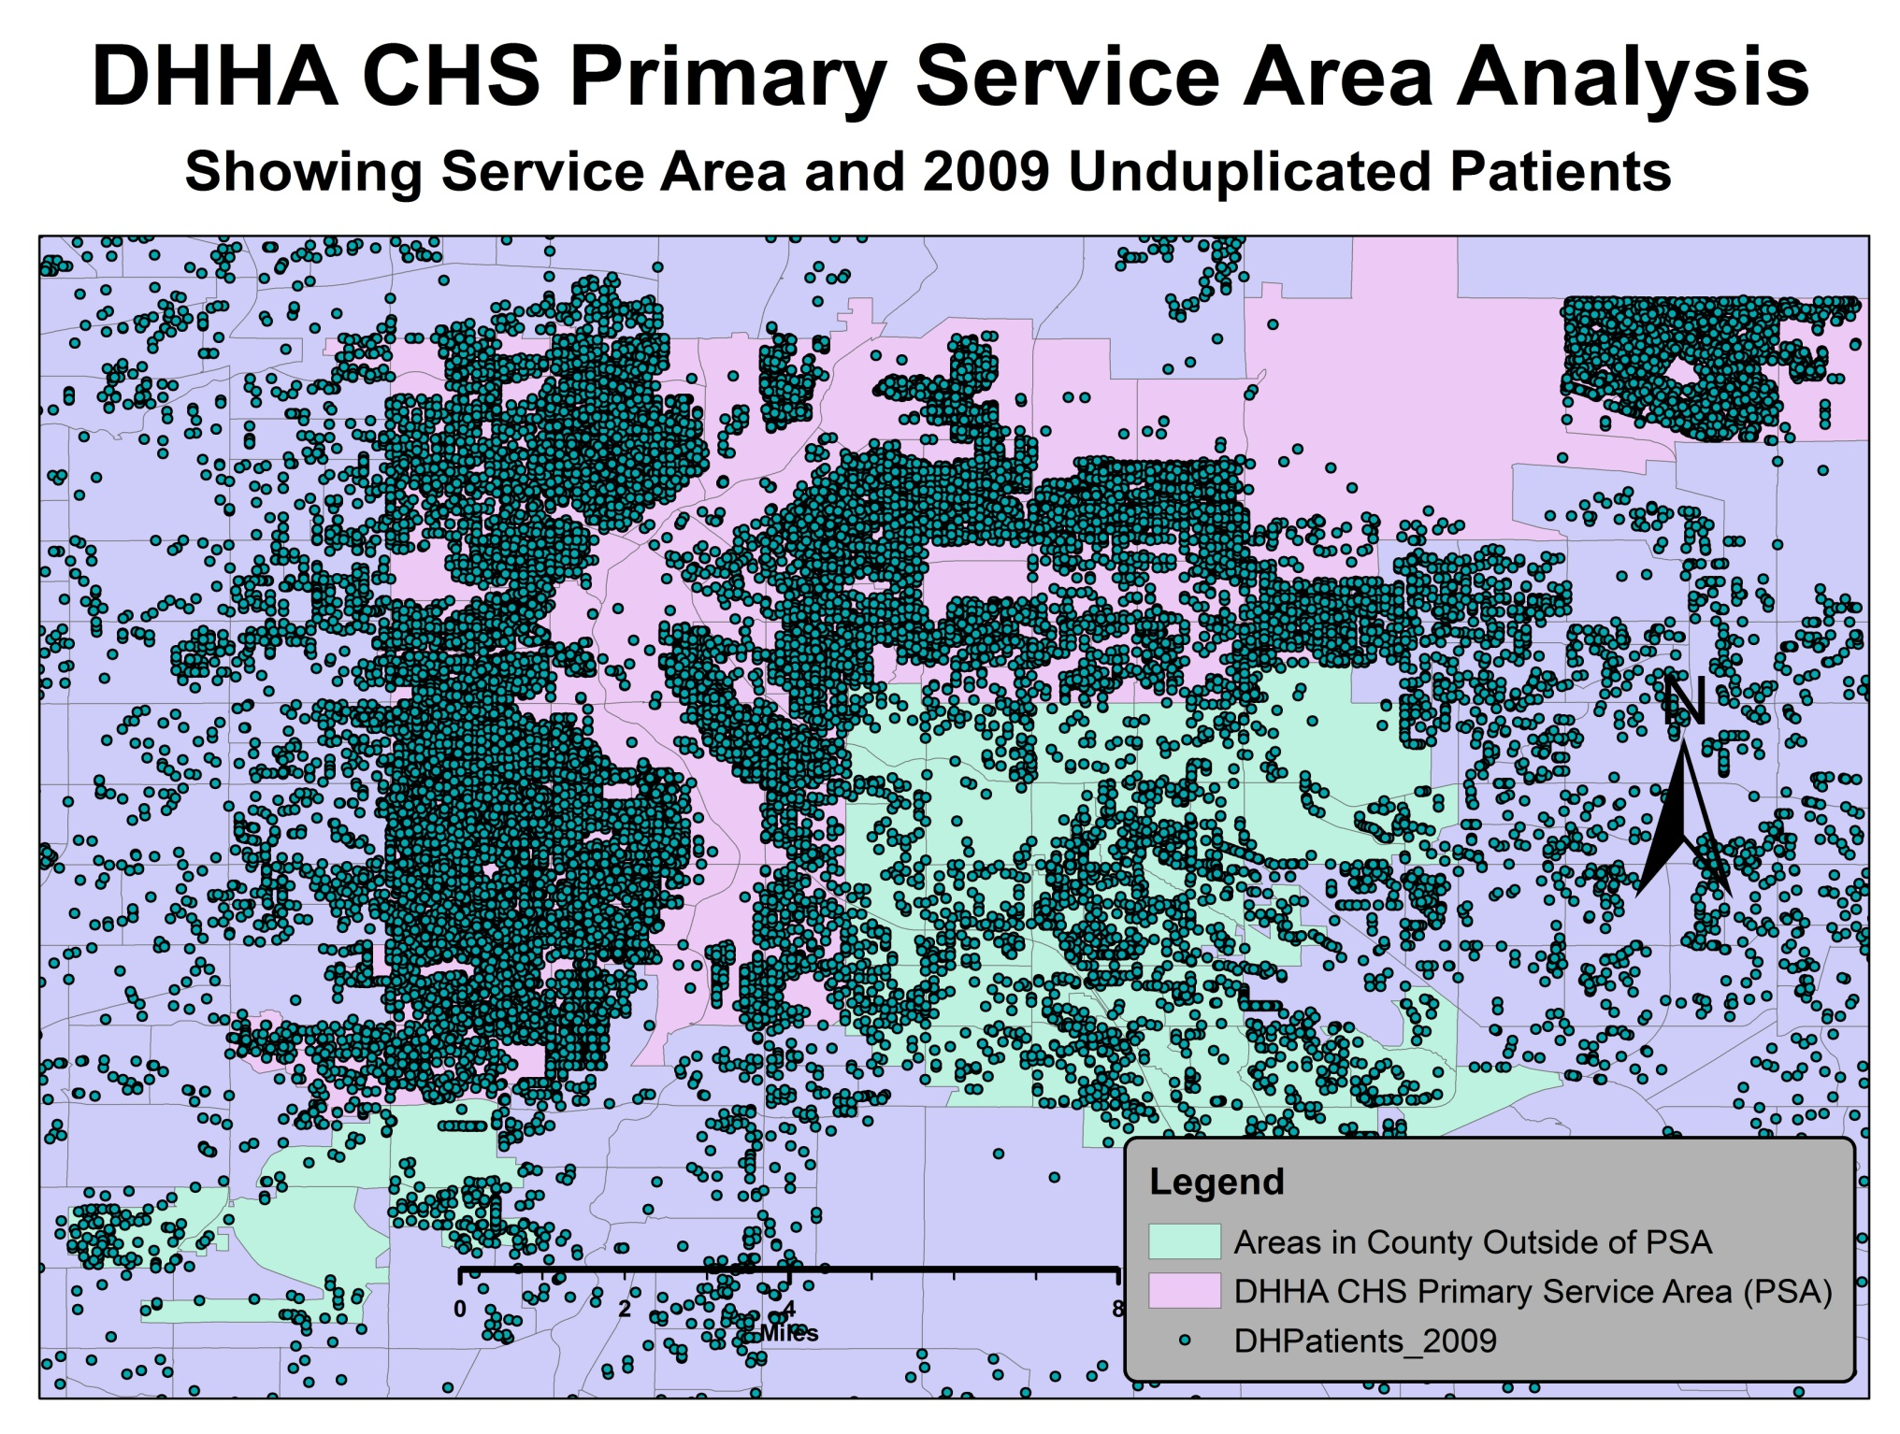
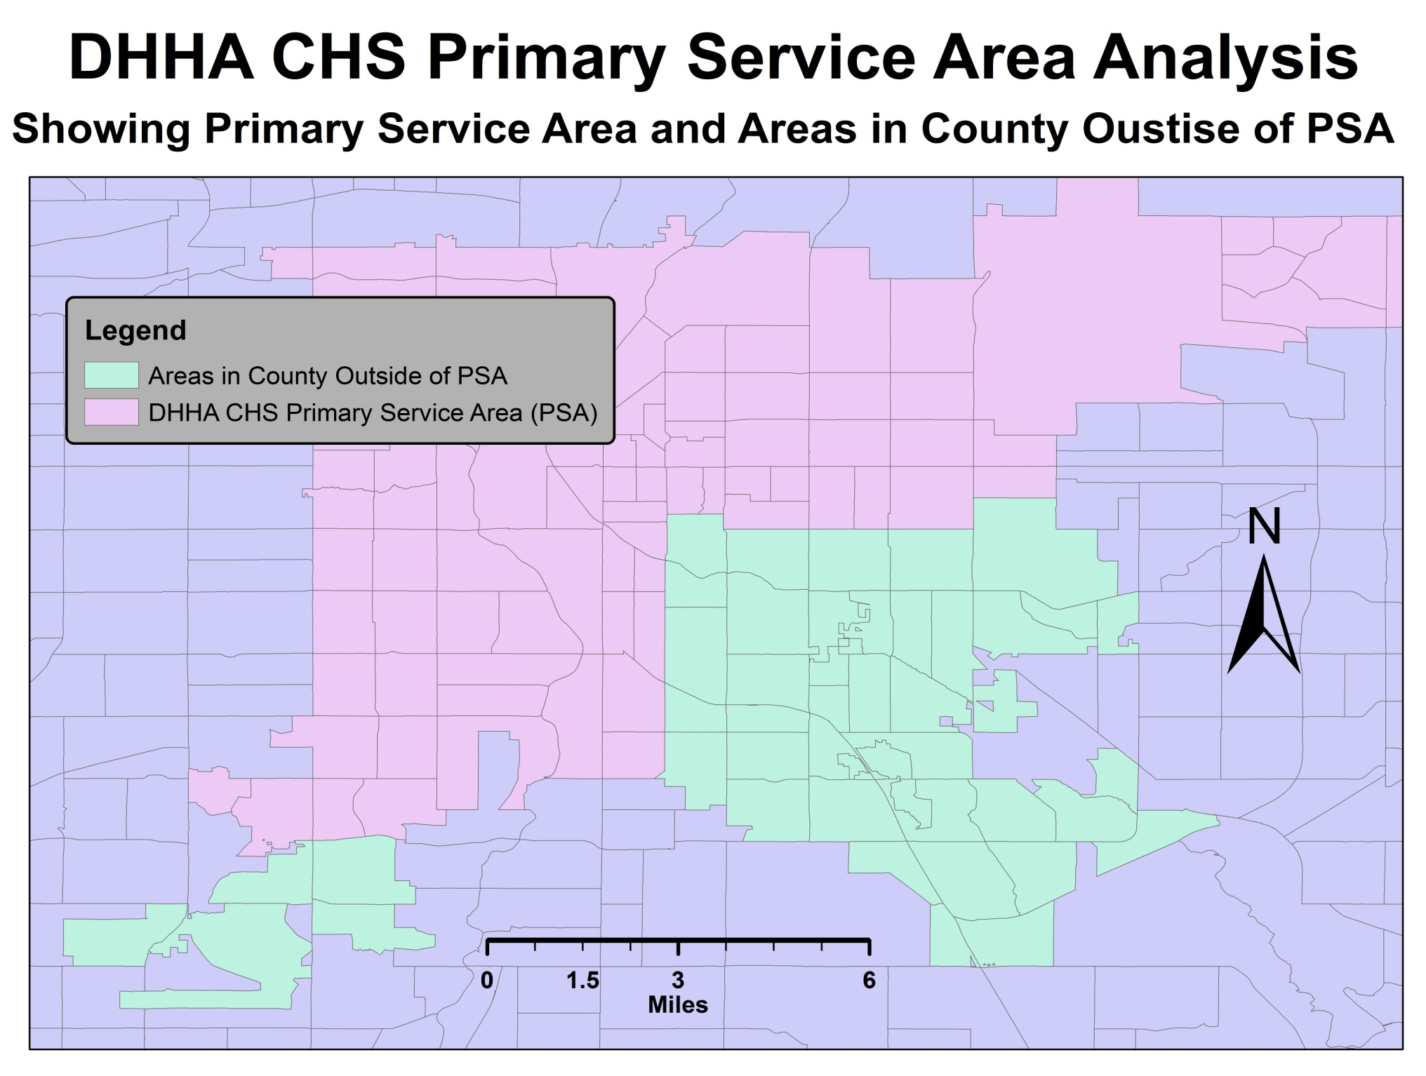


DHHA CHS 2009 Unduplicated Patients
DHHA CHS Primary Service Area (PSA)
Areas in Denver County Outside of PSA
DHHA CHS Patients, 2009

Slide 28
American Healthcare
2008 Local Government Support of Safety Nets
Hospital | Uncompensated Care | Local Support | % Local Support
Denver Health | $318M | $27.5M | 8.6%
Parkland | $600M | $375M | 62.5%
San Francisco General | $251M | $217M | 86%
Average Government Support: 22%

Slide 29
American Healthcare
Denver Health is cost efficient:
  Denver Health charges for medical services are lower than the average for metropolitan Denver peer hospitals in all of the 35 DRGs.
  Denver Health’s charges were the lowest of any peer metro Denver hospital in 26 of the 35 categories.
  CHA 2009

Slide 30
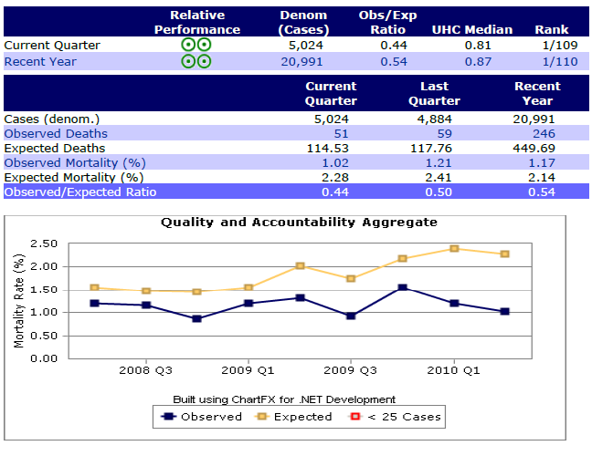

Slide 31
American Healthcare
IT
Right
Person
Right Process
Patient and Family
Right Communication
Right Service
Right Environment
Right Reward
©

Slide 32

Lean
WASTE
15

Slide 33
American Healthcare

Slide 34
American Healthcare
Conclusion
  The current state of American healthcare cannot and should not be sustained
  We must find and replicate new models for our health care system
  Everyone should embrace a less costly, higher quality, more just American health care system.

